Slide 1
Phresco Testing Framework
Automation Tool - Selenium

Slide 2
Agenda
Basic Introduction to Selenium
Explanation on the components of Selenium
Steps to create project using Phresco
Steps to integrate Maven with Eclipse and import java Maven project
Folder structure followed in Phresco
Best practice in Phresco Testing Framework
Achievements and RoadMap

Slide 3
What is Selenium?
Selenium is an Open source automation testing tool
Using Selenium Web based applications can be automated but desktop applications cannot be done
Selenium is an Easy, flexible and most widely used testing tool

Slide 4

Supported Browsers, Languages & OS
Browsers
Languages
OS
Firefox:3.0 and above
Google Chrome: Version 11 and above (except for PHP, Drupal web driver migration)
Internet Explorer: Version 9 and above
Opera: Version 10 and above
Safari: Version 5 and above (as of now Selenium RC is only supported for functional tests)

Slide 5




Supported Browsers, Languages & OS
Browsers
Languages
OS
Java, C#, Ruby, Python, PHP, Pearl etc.

Slide 6



Supported Browsers, Languages & OS
Browsers
Languages
OS
Windows, Mac, Linux, Unix etc.

Slide 7
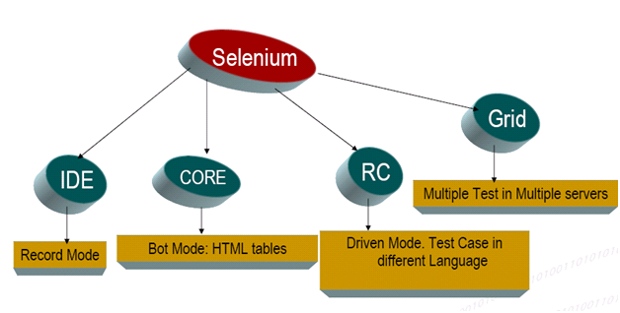
Components of Selenium
Selenium has a set of distinctive inbuilt software's in it
Each tool holds a different approach to support the test automation
Following are the components of Selenium
Selenium IDE
Selenium RC
Web Driver
Grid

Slide 8
Selenium IDE
Selenium IDE is an Integrated Development Environment used for building test cases in Selenium.
It acts a Firefox plug-in/add-on and is used as a record and play-back tool.
Selenium-IDE is useful for beginners who has no programming knowledge.
Tests can be recorded and exported in different languages. Exported tests can be run against different browsers using Selenium Remote Control.

Slide 9
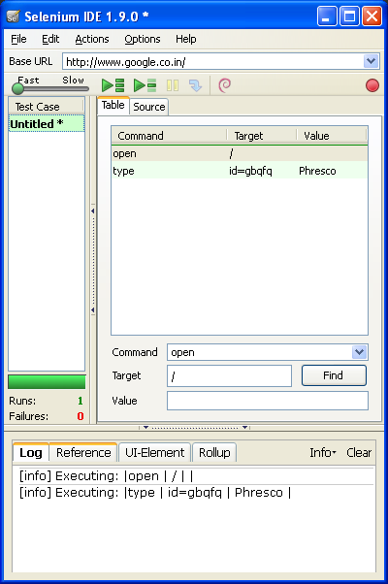
Selenium IDE
Once Selenium-IDE is installed, you can find it as Tools →Selenium IDE in Firefox browser
Record Button
Play entire Test Suite
Play current Test Case

Slide 10
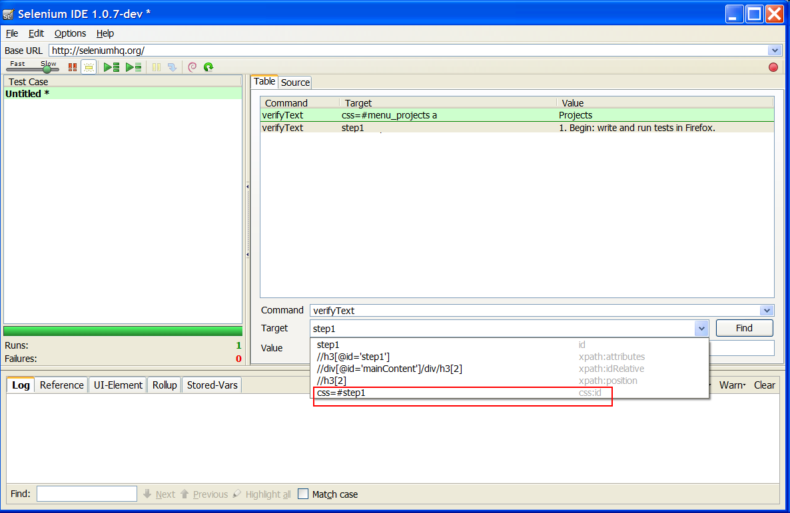
Capturing X-Path Values

Slide 11
Selenium IDE - Limitation
Biggest drawback of Selenium IDE is its limitation in terms of browser support
Can record and playback only in Firefox browser alone

Slide 12
Selenium RC
Selenium RC is yet another component of Selenium which works on multiple browsers.
Selenium RC acts as two components:
Selenium Server
Receives Selenium commands from your test program
Interprets them and pass them to AUT
Reports back to your program the results of running those tests
Client Libraries
The client libraries provide the programming support using different languages

Slide 13
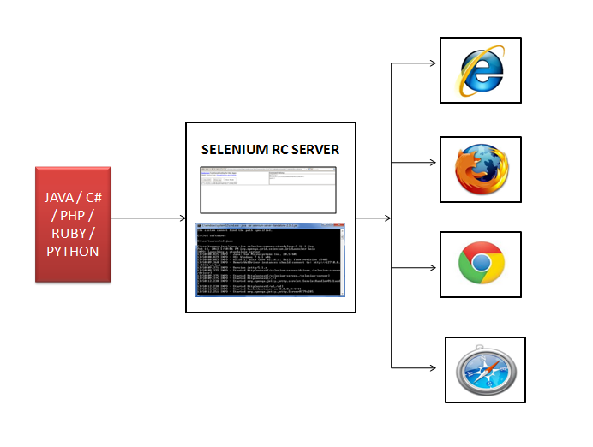
Selenium RC Architecture

Slide 14
Selenium RC - Limitation
Requires Selenium RC server to be running
Cannot test mobile applications
Works on almost all browsers but supports only limited versions (e.g. supports up to FF 7.0)
Cannot handle dynamic web pages and pop-ups effectively

Slide 15
Selenium Webdriver
To overcome the limitations of Selenium RC, Webdriver was introduced
Webdriver interacts directly with the driver of the respective browser for executing the test cases
Purely an Object-oriented API
Can handle dynamic web pages

Slide 16
How Does WebDriver ‘Drive’ the Browser Compared to Selenium-RC?
Selenium RC
Selenium RC Server will receive the commands from your test program, interprets and passes them to AUT
Requires Server to start
Selenium Webdriver
Rather than being a JavaScript application running within the browser, it uses whichever mechanism is most appropriate to control the browser
No server required to start

Slide 17
Advantages of using Webdriver
Cleaner and better API for OO automation development
Simpler API
HTML Unit Support
IE 9 ,and other browsers with latest versions.
IOS/Android
Better/Native Browser Interaction
Better popup and dialogs handling
Web driver scrolls elements into view when you select of click on them.
Cleaner multiple Window Interaction

Slide 18
Selenium Grid
Allows to run tests in various platforms and browser configurations in parallel
Reduces the test execution time
Selenium Grid runs over Selenium RC i.e. with selenium grid, multiple instances of selenium RC will run on various OS and different browser configurations, each of the these when launching will register to a hub.
Tests will be sent to Hub → Hub will check which RC is available→ Available RC will launch the browser and trigger the test

Slide 19
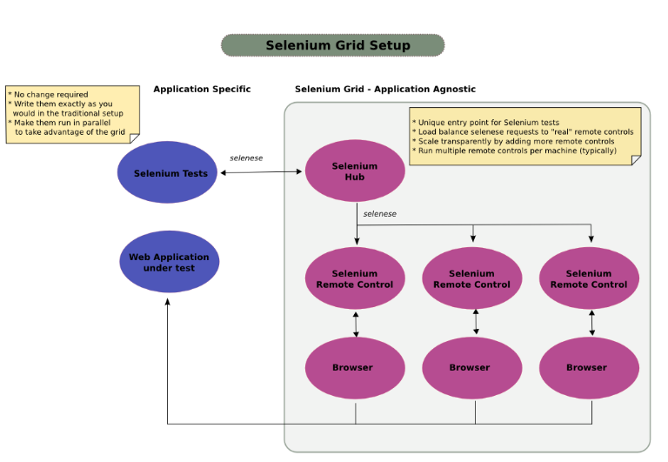
Selenium Grid Architecture

Slide 20
Grid Versions
Grid 1 and Grid 2 are the currently available versions with Selenium
Basic drawback of Grid 1 is that it uses Ant tool and requires an RC server to be in running state for executing tests
Whereas, Grid 2 is fully based on Webdriver concepts and hence most widely used

Slide 21
Pre-requisites
Firefox (For Selenium IDE)
Java jdk (not JRE)
Download Location:
Selenium IDE from
http://release.seleniumhq.org/selenium-ide/1.9.0/selenium-ide-1.9.0.xpi should be installed
After installation - Selenium IDE option in Firefox which is added as a plug-in will be seen.
Selenium Webdriver JAR file should be downloaded from: http://selenium.googlecode.com/files/selenium-server-standalone-2.25.0.jar should be downloaded

Slide 22
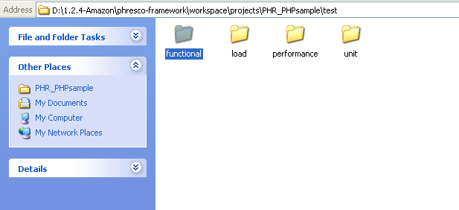
Creating Sample Project in Phresco
Import the functional test folder available in this path to eclipse:
/workspace/projects/PHR_Sample/test/functional
Note: Make sure Maven is integrated with Eclipse before importing Phresco complaint projects. (Maven is the build tool used by Phresco)

Slide 23
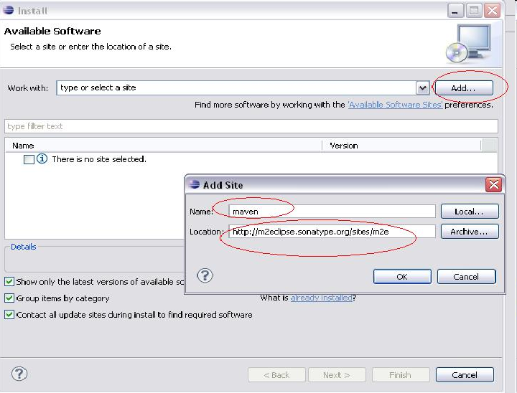
Maven Integration
In Eclipse → Go to Help → Install New Software

Slide 24
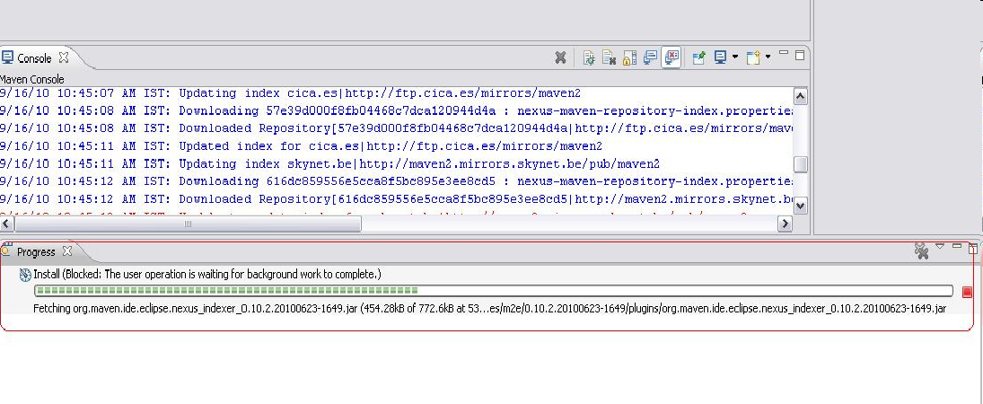
Maven Integration
The download and installation happens in background as shown below
On Successful installation you would be prompted for eclipse restart. Accept the restart confirmation to restart your eclipse

Slide 25
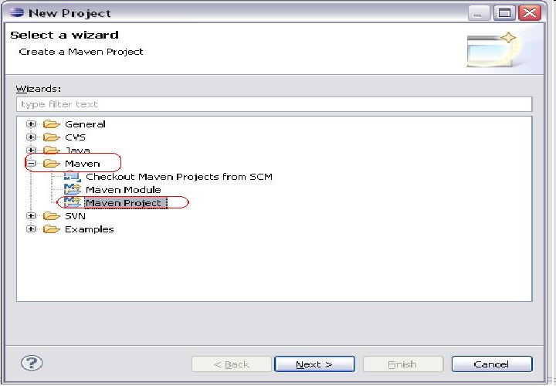
Creating Maven Project in Eclipse
In Eclipse navigate to File >> New Project >> Maven >> Maven Project

Slide 26
Adding Dependency in pom.xml
<dependency>
<groupId>com.oracle</groupId>
<artifactId>ojdbc14</artifactId>
<version>10.2.0.</version>
<scope>system</scope>
<systemPath>DRIVER NAME:/oracle/webdriver/ojdbc14--10.2.0.jar
</systemPath>
</dependency>

Slide 27
Importing Java Maven project into eclipse
Select File→ Import in Eclipse editor

Slide 28
Functional test folder structure
Maintains Code Implementations
Utility Classes
Constant values used to describe the roles of various UI objects in an application
Raw data and user inputs
Test Cases & Test Suites
Maven Dependencies
Pom.xml

Slide 29
Steps to create Selenium test cases
Re-Usable Methods
Common methods will be defined in the screen classes available in /src/main/java directory
Constant Declaration
Constants will be maintained in util classes under /src/main/java directory
Inputs assigned to constants
Raw data will be maintained under /src/main/resources
Testcases
All the Junit Test cases will be maintained under /src/test/java directory
TestSuite creation
Testsuites and test cases will be maintained under /src/test/java
Maven dependencies→pom.xml
All the maven dependencies will be mentioned in pom.xml file

Slide 30
Test Case
The test case, is a set procedure that guides a tester to execute a test
Test cases are individual java classes which perform unique testing scenarios against the application
Test Suite
A TestSuite is a Composite of Tests. It runs a collection of test cases
This is also a JUnit suite class which calls the rest of the individual test cases

Slide 31
Test Method
Test method is written for testing an activity.
There can be n number of test methods under a test case.
Test case calls the test methods

Slide 32
Creating a Test Suite
To create a suite class
Suite Class: This is also a JUnit suite class which calls the rest of the individual test cases
Right click on the project created Select new →others →java→ JUnit→ Junit suite class

Slide 33
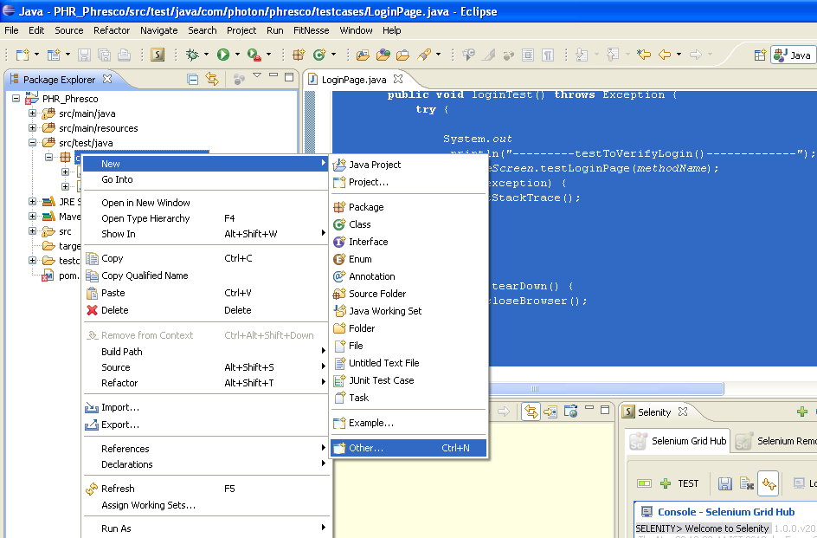
Creating a Test Suite

Slide 34
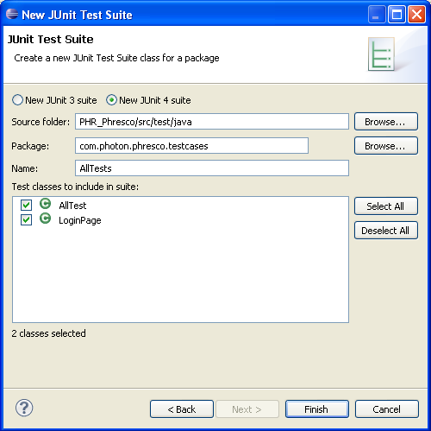
Importing Java Maven project into eclipse
Select the test cases that should be grouped under the testsuite (if any)

Slide 35
AllTest (Test Suite)
This is a root JUnit suite class that can either call a suite of classes or individual test cases.
In Phresco testing Framework a JUnit suite class is named as “AllTest”.
Following is the AllTest file which shows up how to add / include another suite class inside it.
package com.photon.phresco.testcases;
import org.junit.runner.RunWith;
import org.junit.runners.Suite;
import org.junit.runners.Suite.SuiteClasses;
@RunWith(Suite.class)
@SuiteClasses({Registration.class,LoginPage.class})
public class AllTest {
}

Slide 36
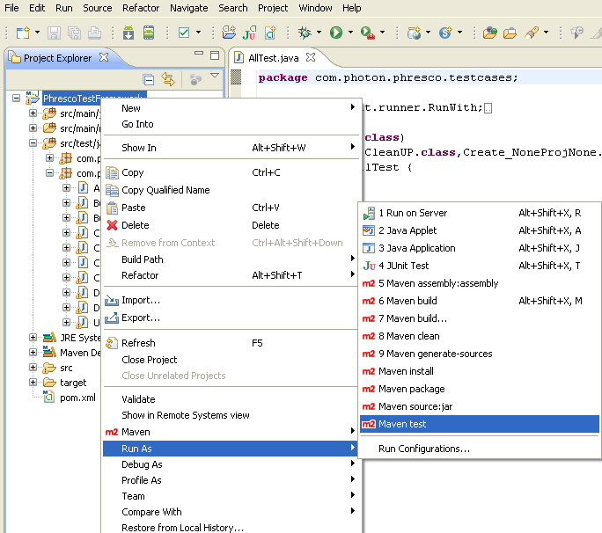
Maven Test Execution in Eclipse

Slide 37
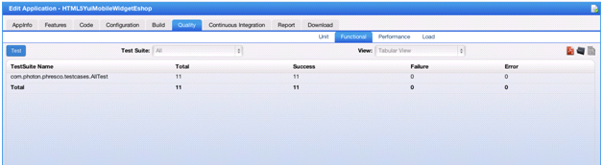
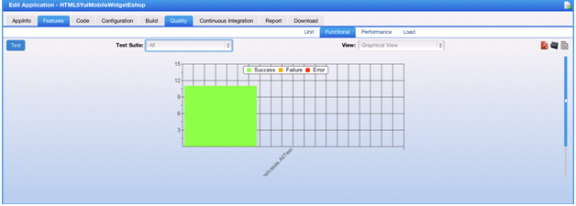
Report Generation in Phresco- Success Report

Slide 38
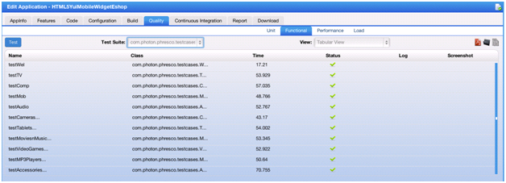
Success Report - Continued

Slide 39
Success Report - Continued

Slide 40
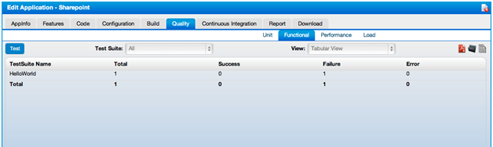
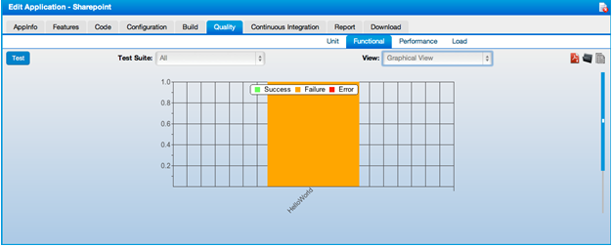
Sample Failure Report

Slide 41
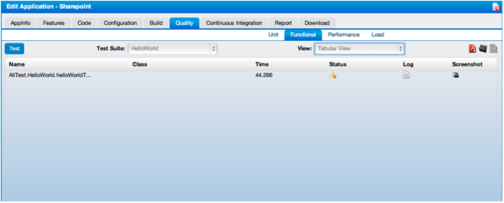
Failure Report - Continued

Slide 42
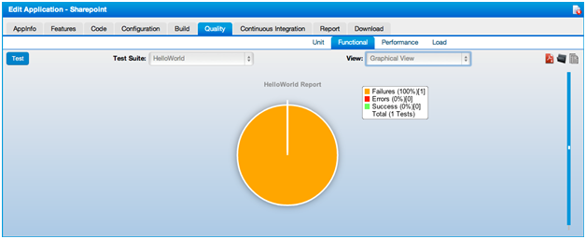
Failure Report - Continued

Slide 43
Achievements and Road Map
Phresco QA team has written automation test scripts for few accounts like
L’Oreal(Makeup.com),
JnJ(Zyrtec,Mobility…)
Walgreens(Loyalty)
Bestbuy(PDTS,DigitalDeals..)
SSBT(CRA,BPC,IVL,SRE,DGF)
NBO1(MyTouchtunes,Karaoke)
VWR(Widget and Android applications)
NetSmart
HorizonBlue(Corporate Website)
Support for Selenium Grid and TestNG in 2.0 Release of Phresco

Slide 44
Q & A

